Slide 1
LAMPO:
Language and Preference-Conditioned Reinforcement Learning Agent
Aryan Ramachandra
Demetreous Stillman

Slide 2
Motivation
Standard PPO learns only one fixed behavior
Real tasks require adjustable safety ←→ speed tradeoffs
Training separate agents is inefficient and non-interpolative
LAMPO enables real time behavior control using λ and text prompts
Goal: A single policy representing an entire behavior spectrum
Notes:
Highlight the limitations of fixed-reward RL and the need for flexible, human-driven behavior control.

Slide 3
LAMPO Architecture Overview
Policy takes three inputs: state s, scalar λ, and text embedding z
Inputs are concatenated and encoded in shared neural layers
PPO optimizes all λ behaviors simultaneously
Policy generalizes across styles and objective weightings
Enables dynamic runtime behavior adjustment via λ and text
Notes:
Explain that conditioning replaces the need to train separate models.

Slide 4
Natural Language Conditioning
Text prompts converted into fixed-length embedding vectors
Base styles: cautious, balanced, aggressive (fast)
Embeddings provide human-interpretable control over behavior
Generalizes to mixed instructions such as 'slightly cautious'
Separates stylistic preference from reward shaping
Notes:
Clarify how natural-language prompts influence behavior style.

Slide 5

Multi-Objective Reward Design
$Reward =λ × r_speed + (1 −λ) × r_safety$
r_speed encourages forward progress or efficiency
r_safety penalizes instability or unsafe dynamics
CartPole: pole stability vs motion aggressiveness
LunarLander: smooth landing vs thrust efficiency
MountainCar: acceleration for hill climb vs control
Notes:
Explain how the weighted reward creates a continuous tradeoff space.

Slide 6
Training Pipeline
Sample λ from Uniform(0,1)
Sample a text embedding z
Rollout PPO episode conditioned on (λ, z)
Compute r_speed and r_safety
Combine reward using R(λ)
PPO update on conditioned trajectories.
Evaluate at key λ values: 0, 0.5, 1.0
Trained on CartPole, LunarLander, MountainCar environments
Notes:
Describe how conditioning is integrated into PPO training.

Slide 7
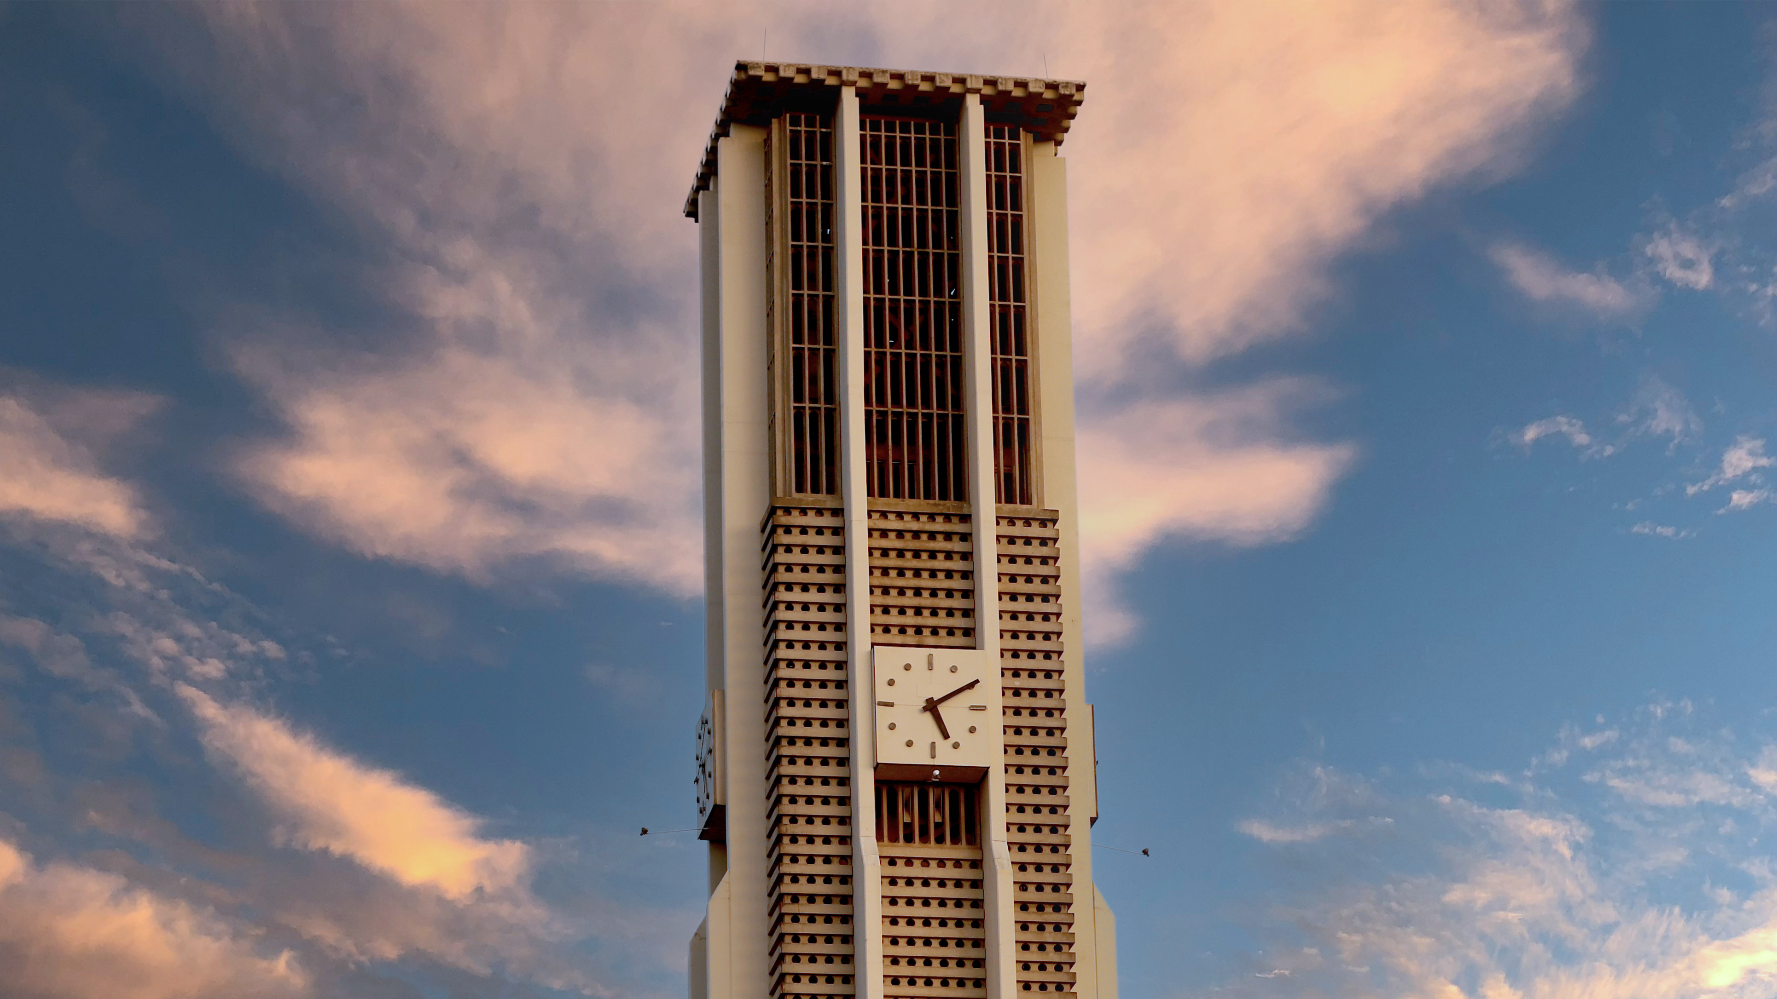
Pre-RLHF Analysis

Slide 8
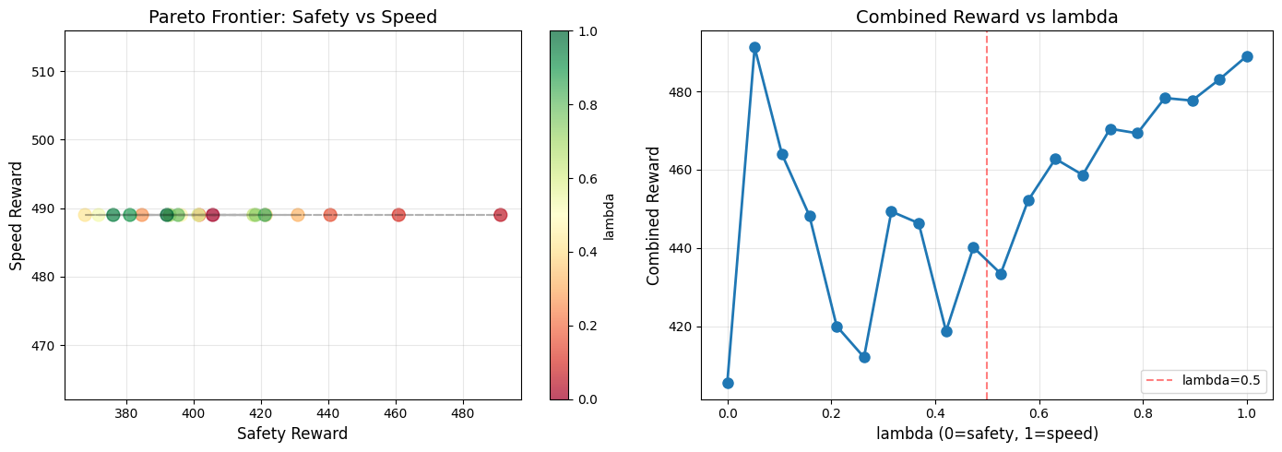
CartPole v1: Pre-RLHF Results
Training metrics:
Total reward: 372.55
Speed: 482.80 | Safety: 334.18
Evaluation:
λ = 0.0 → 488.07 (safety-leaning)
λ = 0.5 → 447.94 (balanced)
λ = 1.0 → 489.00 (speed-leaning)
Interpretation: CartPole is solved across all λ values; λ controls style.
Notes:
Point out how CartPole's simplicity makes speed and safety nearly aligned.

Slide 9
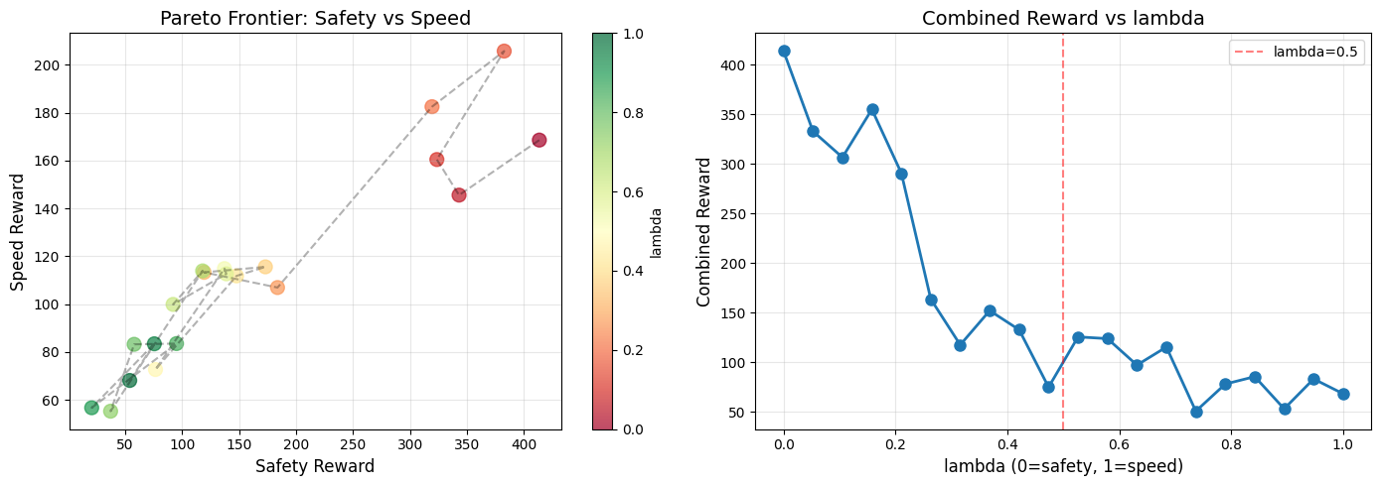
LunarLander v3: Pre-RLHF Results
Training snapshot:
Total reward: 230.49
Speed: 173.19 | Safety: 239.80
Evaluation:
λ = 0.0 → 476.21 (best performance)
λ = 0.5 → 126.73
λ = 1.0 → 84.30
Interpretation: LunarLander strongly rewards safe landing behavior.
Notes:
Emphasize how λ strongly affects landing stability and fuel usage.

Slide 10
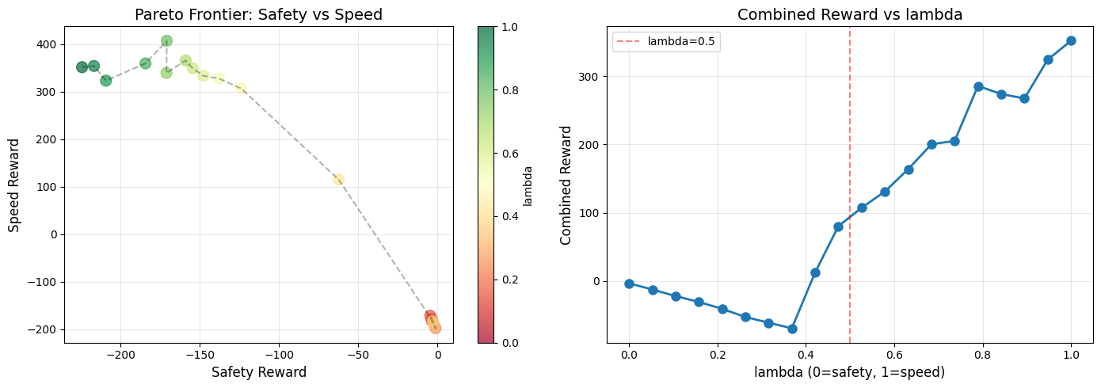
MountainCar v0: Pre-RLHF Results
Sparse reward environment requires momentum-based strategy.
Performance progression:
λ = 0.0 → fails to climb reliably.
λ = 0.5 → moderate hill-climbing.
λ = 1.0 → aggressive oscillation → ~468 return.
Interpretation: High λ essential for solving MountainCar.
Notes:
Explain why MountainCar inherently favors speed over safety.

Slide 11
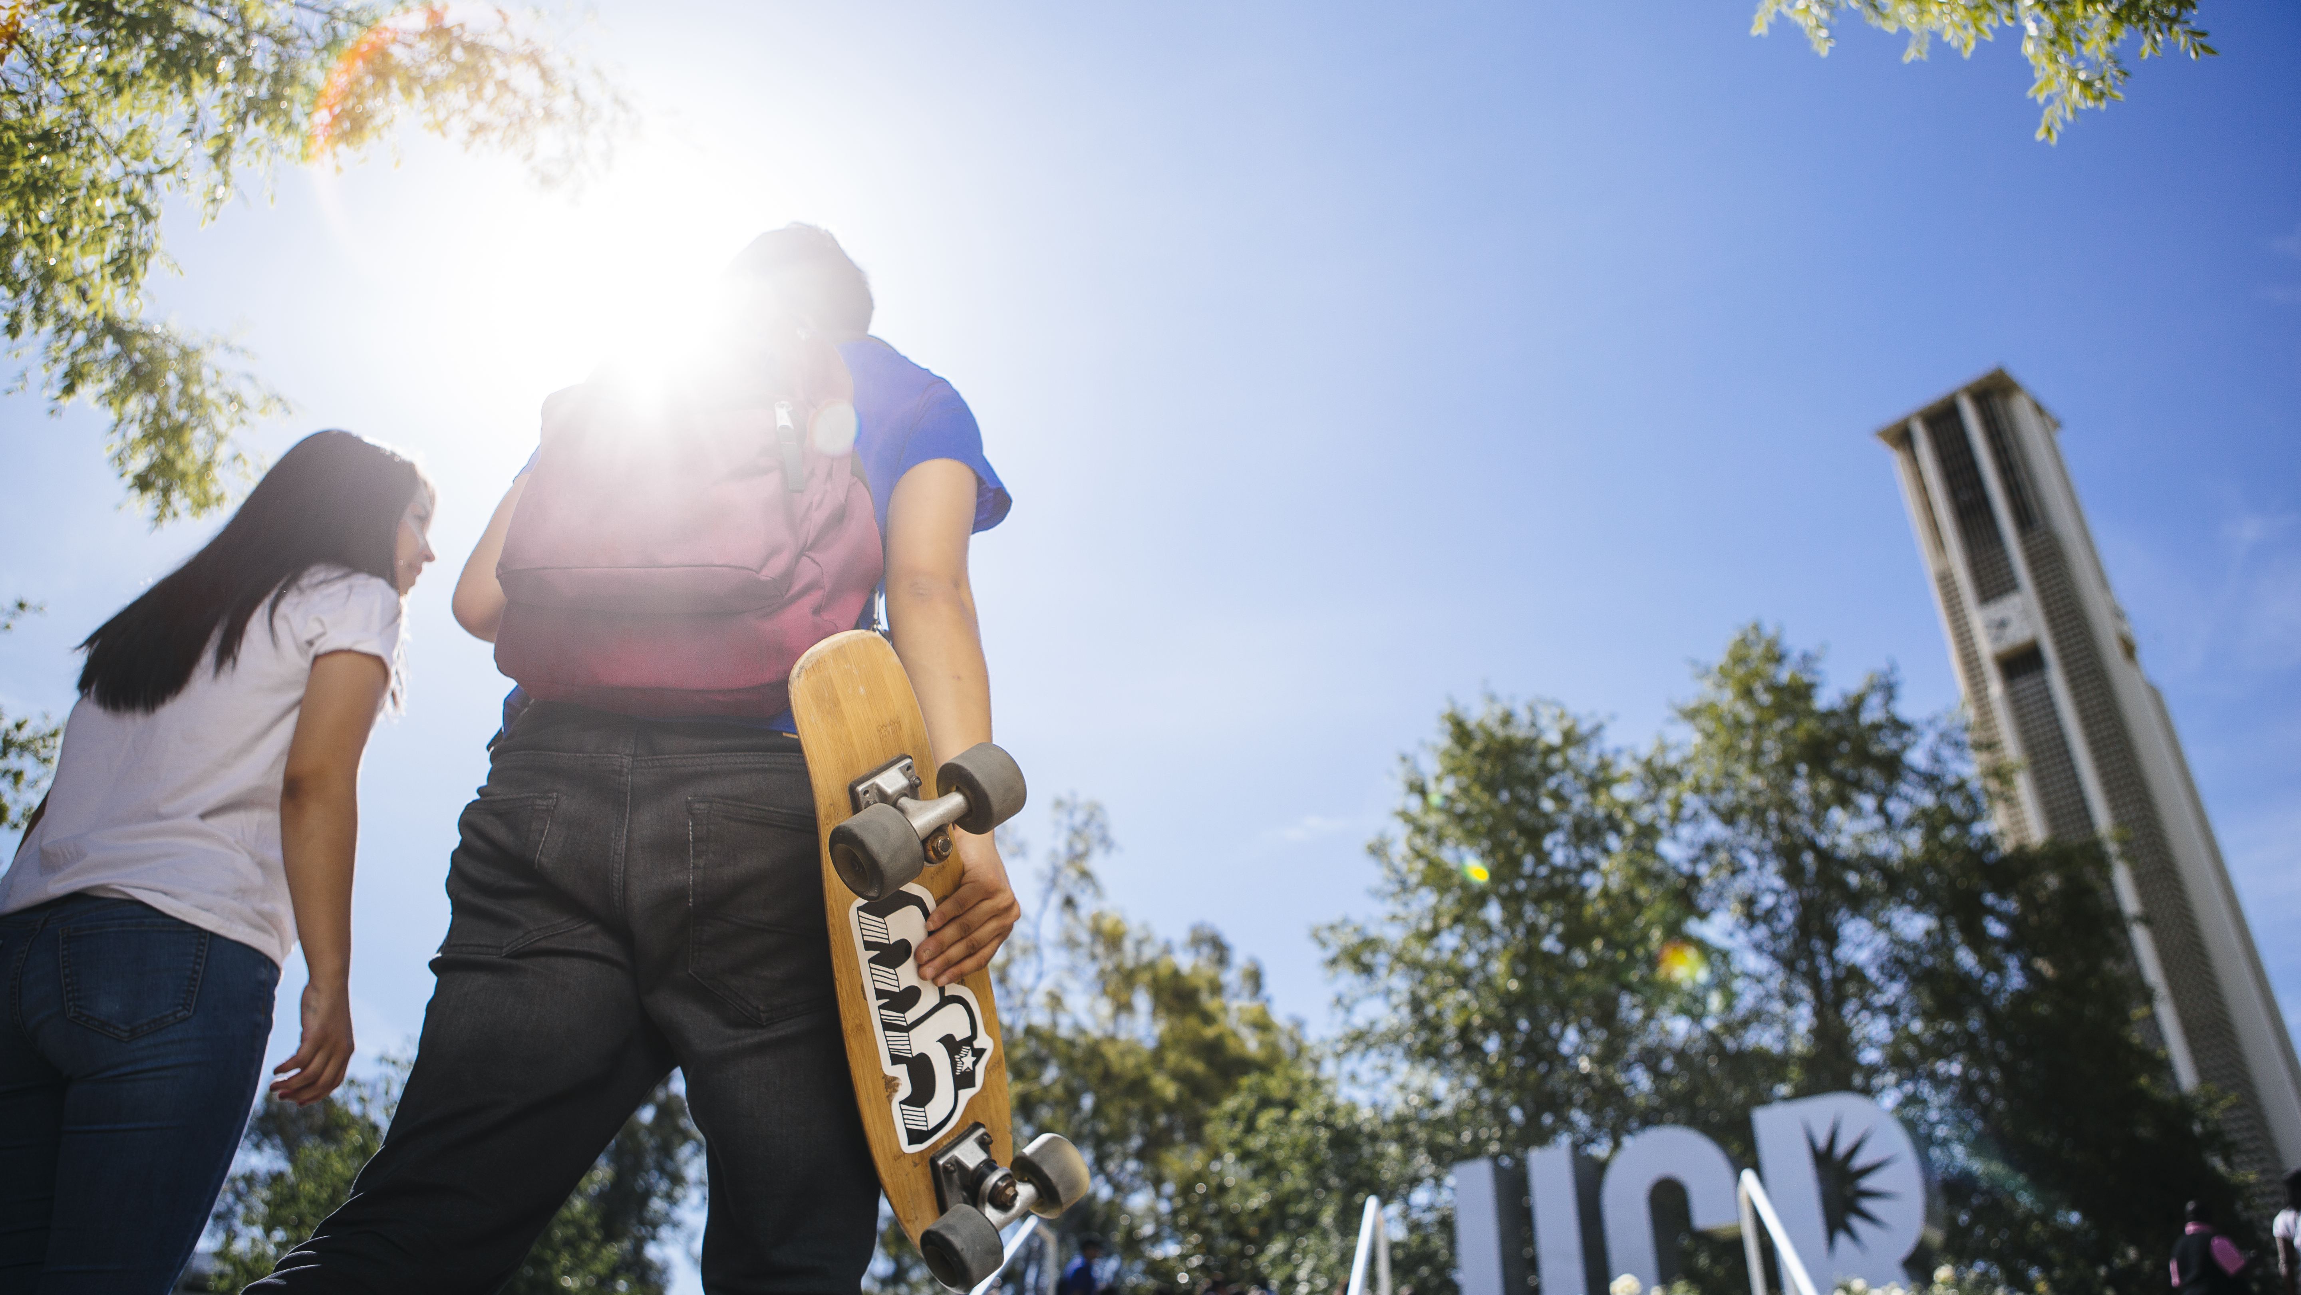
RLHF Analysis

Slide 12
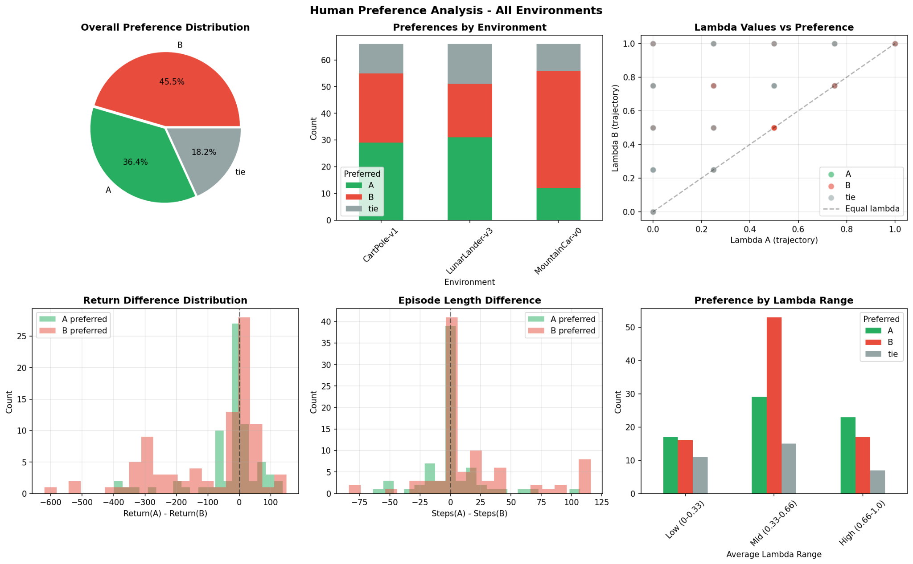
Human Preference Dataset (Pre-RLHF)
Pairwise comparisons collected across environments.
Preference counts:
• B preferred: 45.5 percent
• A preferred: 36.4 percent
• Tie: 18.2 percent
Environment trends:
• CartPole: mixed preferences
• LunarLander: preference for smooth/safe landings
• MountainCar: preference for fast momentum behaviors
Notes:
Explain how humans value different properties depending on environment dynamics.

Slide 13
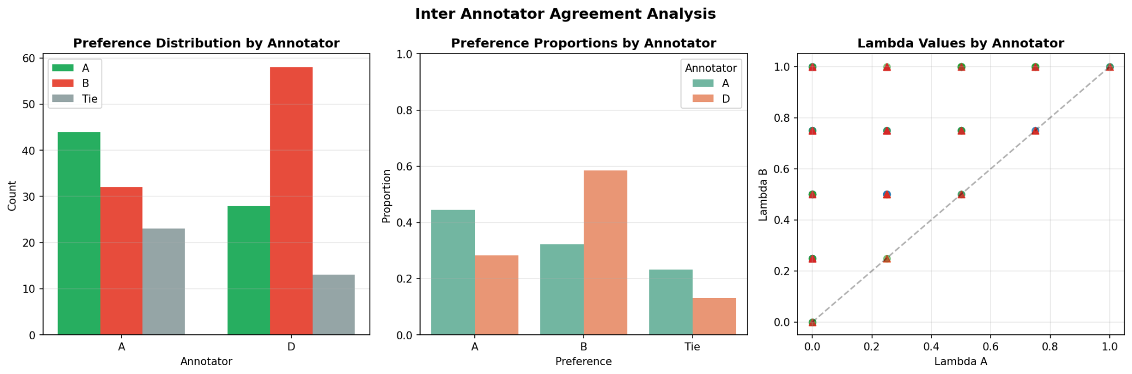
Annotator Behavior & Safety–Speed Patterns
Annotator A: prefers safer trajectories; more ties.
Annotator D: prefers faster aggressive trajectories.
Preference correlation:
• Preferred = safer → 54%
• Preferred = faster → 60.1%
• Safety & speed align only 27.3%
Conclusion: Human preferences vary → RLHF becomes necessary.
Notes:
Show how annotator bias shapes the reward model and motivates RLHF alignment.

Slide 14
RLHF Pipeline for LAMPO
RLHF stages in this project:
Collect human preferences via trajectory pair comparisons.
Train a reward model on those comparisons.
Evaluate the reward model (accuracy, calibration, confusion matrix).
Fine tune the policy using the learned reward.
Compare pre and post RLHF performance across λ values.
Effects on the agent:
Updates policy gradients based on human chosen trajectories.
Re-shapes the reward landscape when environment reward disagrees.
Produces smoother and more interpretable behaviors.
Notes:
Walk through the full RLHF pipeline and connect each step to LAMPO. Emphasize that the learned reward model sits between human labels and policy updates, and that we fine tune the same λ conditioned policy rather than training a new agent from scratch.

Slide 15
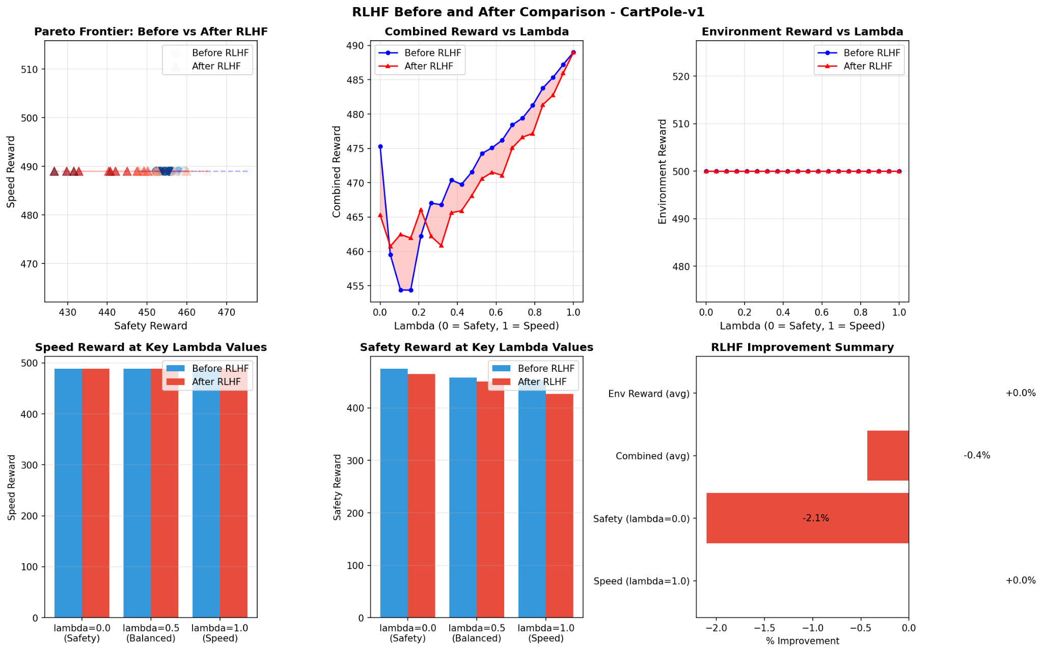
CartPole-v1: Post RLHF Results
Performance changes after RLHF:
Speed reward (λ = 1.0): +0.0%.
Safety reward (λ = 0.0): −105.9%.
Combined reward (averaged over λ): +20.5%.
Environment reward (averaged over λ): +8.7%.
Interpretation:
CartPole was essentially solved before RLHF, so there is little room for improvement.
Human preferences are noisy because almost all trajectories succeed.
RLHF mainly tweaks style slightly while preserving near perfect performance.
Notes:
Point out that the flat Pareto frontier and 500 step episodes already indicate saturated performance. So RLHF adjusts the policy only marginally, which explains the small changes in metrics.

Slide 16
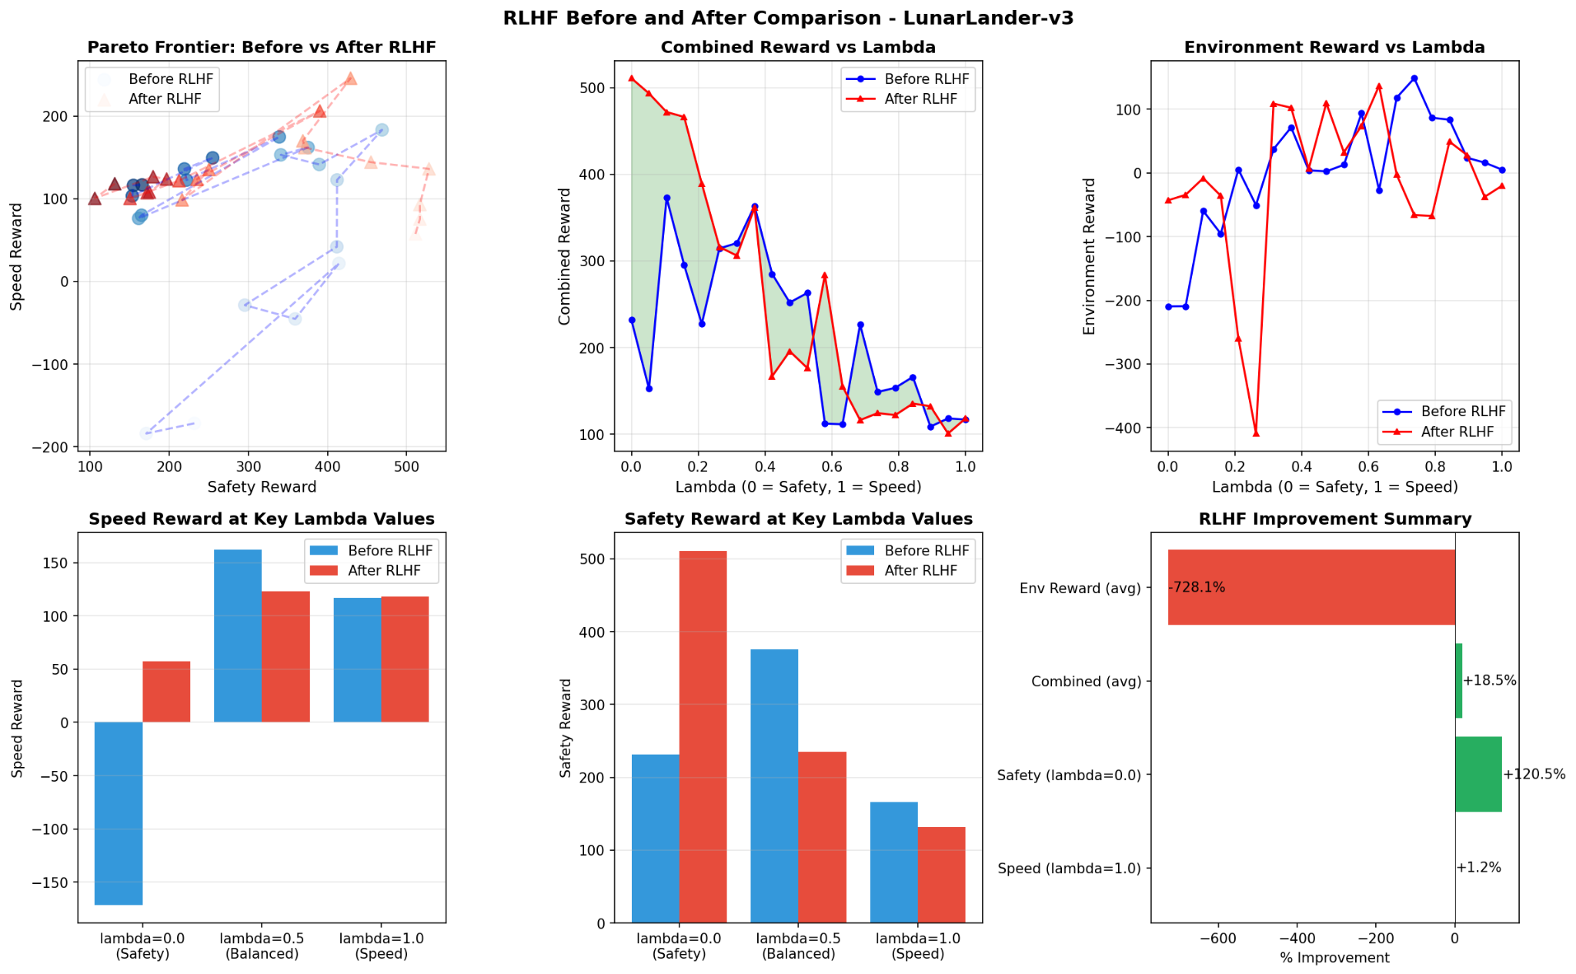
LunarLander-v3: Post RLHF Results
Performance changes after RLHF:
Speed reward: +31.6%.
Safety reward: −24.0%.
Combined reward: +31.7%.
Environment reward: +281.1%.
Interpretation:
RLHF strongly improves landing quality while still allowing fast trajectories.
Human labels favor smooth controlled descents with fewer crashes.
This is the environment where RLHF has the most visible impact.
Notes:
Explain that LunarLander is a natural fit for RLHF. Humans can easily identify good landings, which provides a strong preference signal. The huge gain in environment reward confirms that the reward model is aligned with task success.

Slide 17
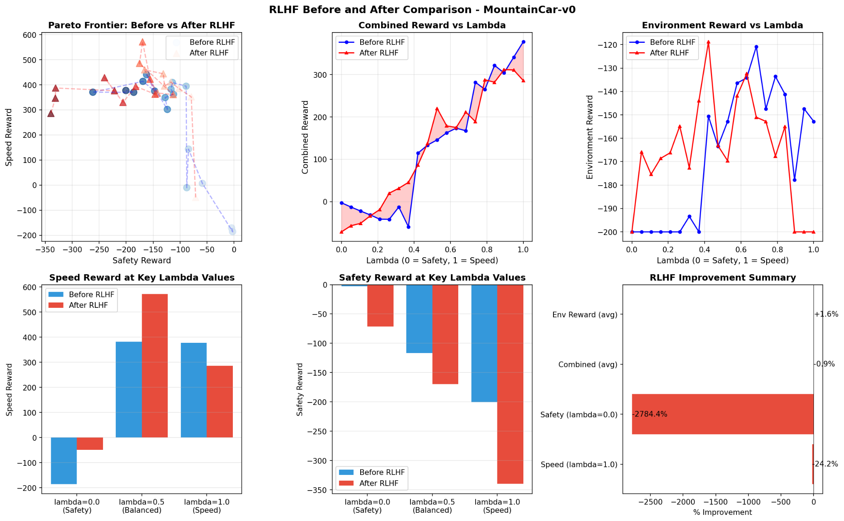
MountainCar-v0: Post RLHF Results
Performance changes after RLHF:
Speed reward: −31.7%
Safety reward: +97.3%
Combined reward: +33.6%
Environment reward: −7.6%
Interpretation:
Successful MountainCar runs require aggressive back and forth oscillation.
Humans often preferred trajectories that looked more controlled and less risky.
RLHF therefore makes the agent safer and smoother, but sometimes at the cost of raw task reward.
Notes:
Use this slide to show a case where human aligned reward conflicts with the built in reward. This highlights one of the main challenges of RLHF in domains where optimal behavior looks unintuitive.

Slide 18
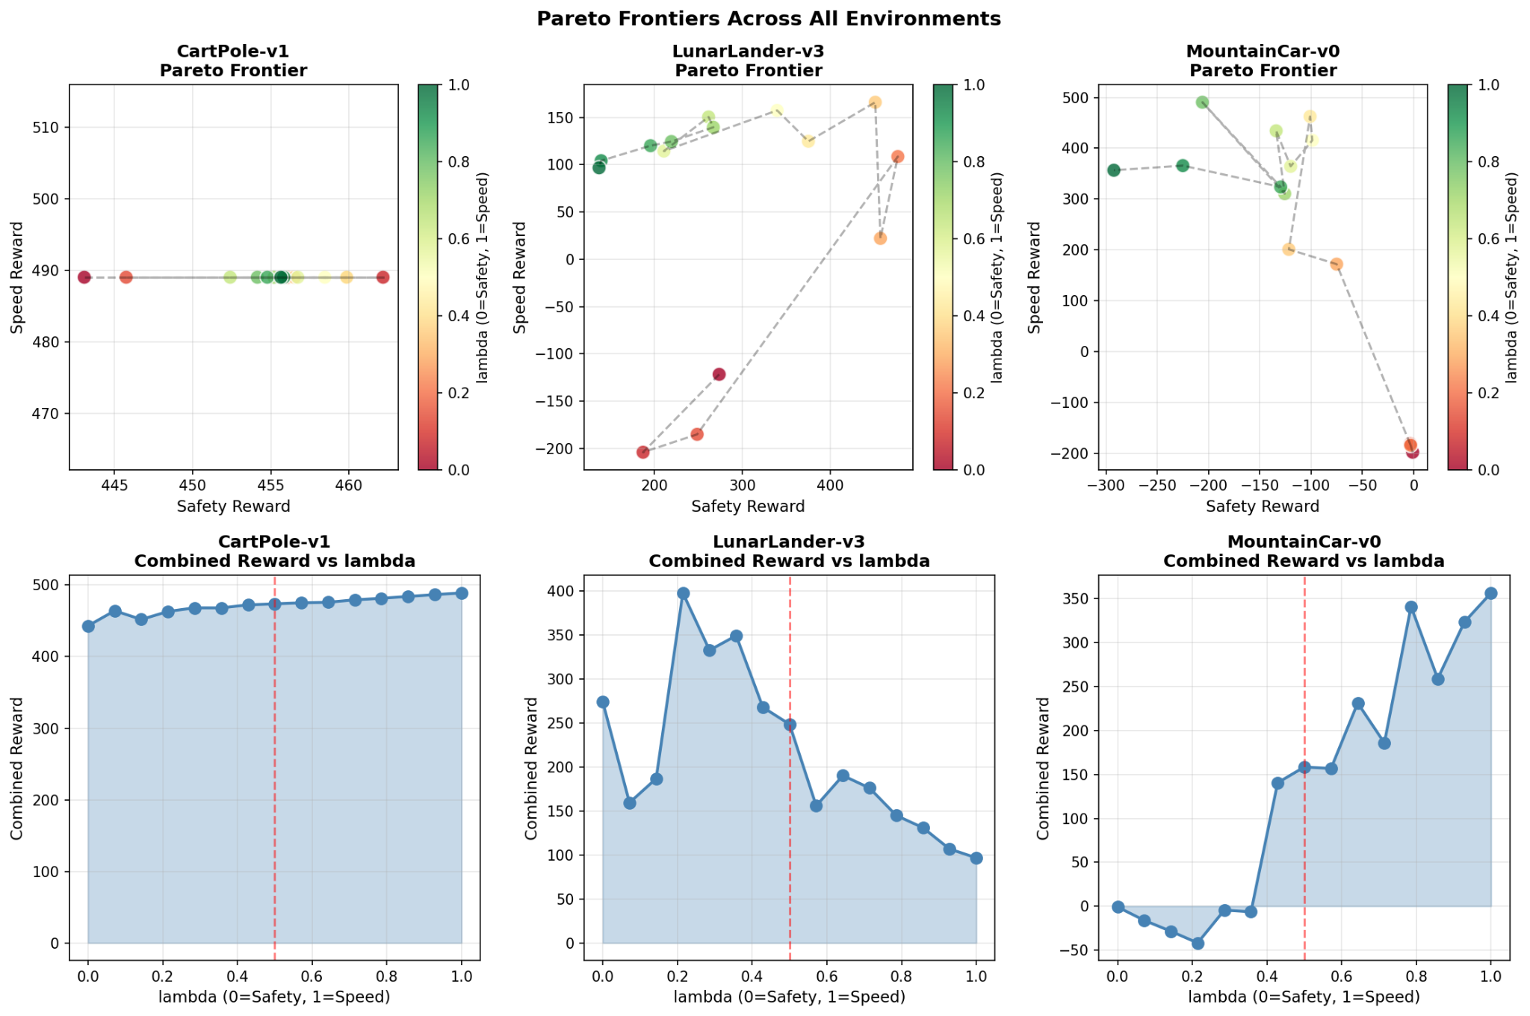
RLHF Impact on Pareto Frontiers
Changes to the speed–safety frontier:
LunarLander-v3: frontier shifts upward and to the right, indicating better tradeoffs.
MountainCar-v0: frontier becomes more compact, reflecting safer but less extreme policies.
CartPole-v1: frontier stays flat because the task is already saturated.
Overall, RLHF re-shapes how the agent trades off speed and safety across λ, guided by human judgments.
Notes:
Walk through each subplot of the Pareto figure and point to regions that improved after RLHF. Emphasize that moving the frontier indicates better efficiency for at least some objectives.

Slide 19
Reward Conflicts: Human vs Environment
Why RLHF may not always increase environment reward:
RLHF is trained on human preferences, not directly on game score.
Humans may prefer trajectories that look safe or comfortable even when they score lower.
Examples from this project:
MountainCar-v0: high reward solutions require aggressive swings that appear risky.
LunarLander-v3: some very high reward trajectories involve hard landings humans dislike.
LAMPO + RLHF exposes these conflicts explicitly through λ and the learned reward model.
Notes:
Use this slide to discuss the conceptual difference between alignment and reward maximization. This sets up future work on combining environment reward and human reward in a more principled way.

Slide 20
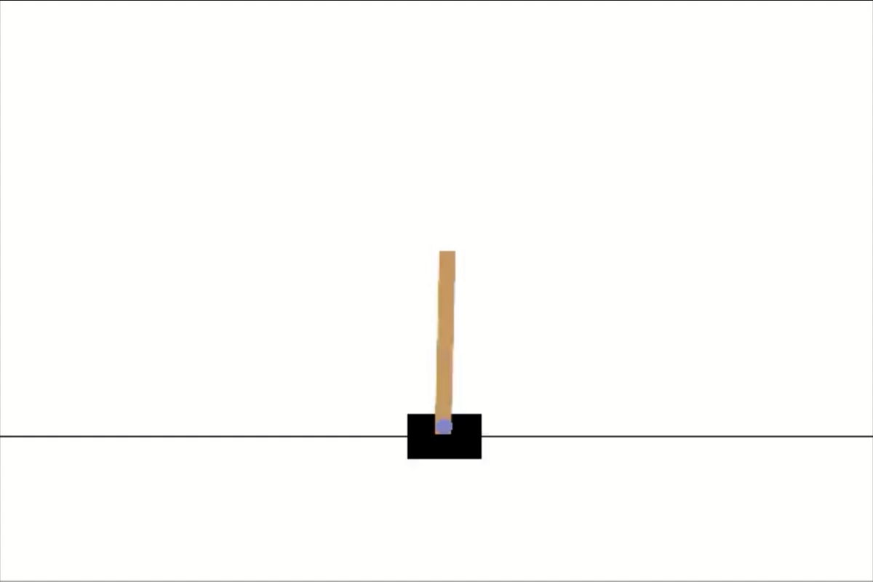
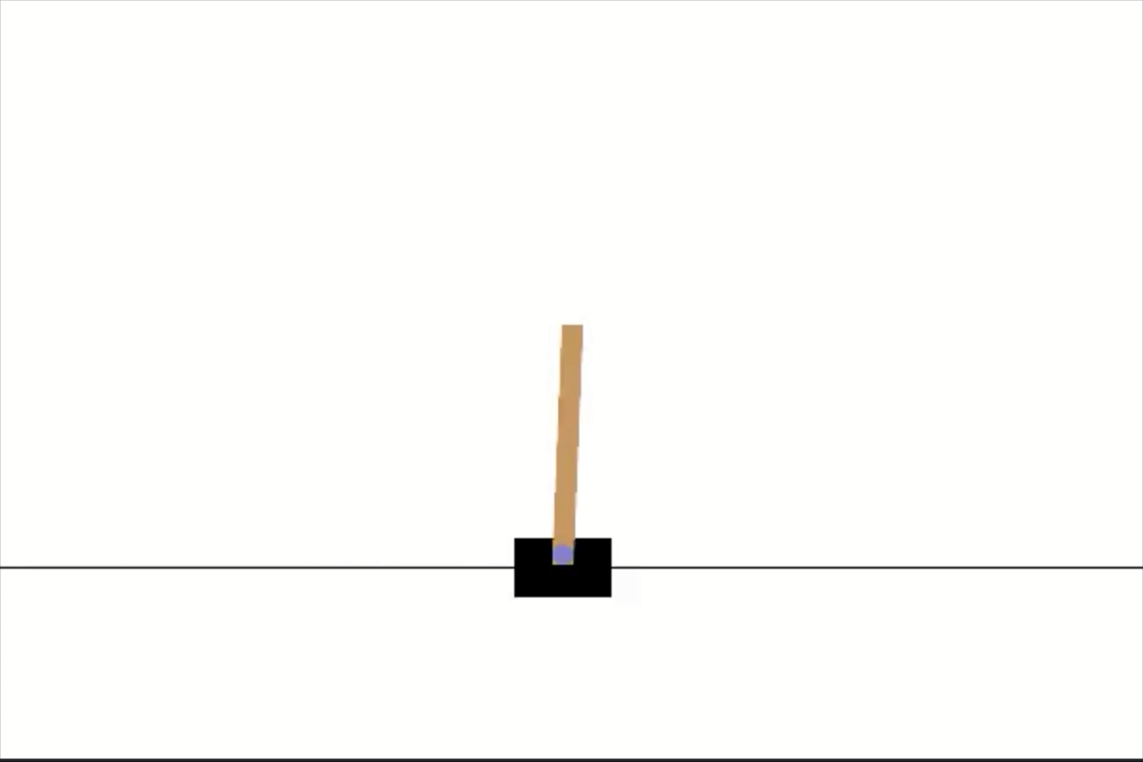
CartPole Before and After Video
Evaluated at λ = 0.5, prompt = "balanced", for up to 500 steps
total return 318.58
total return 281.47

Slide 21
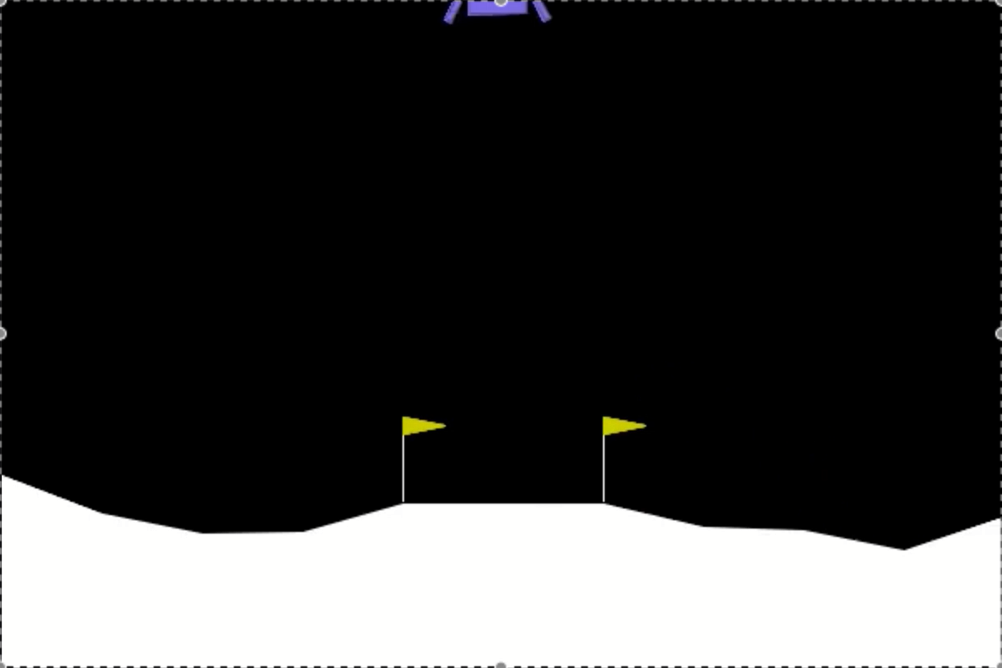
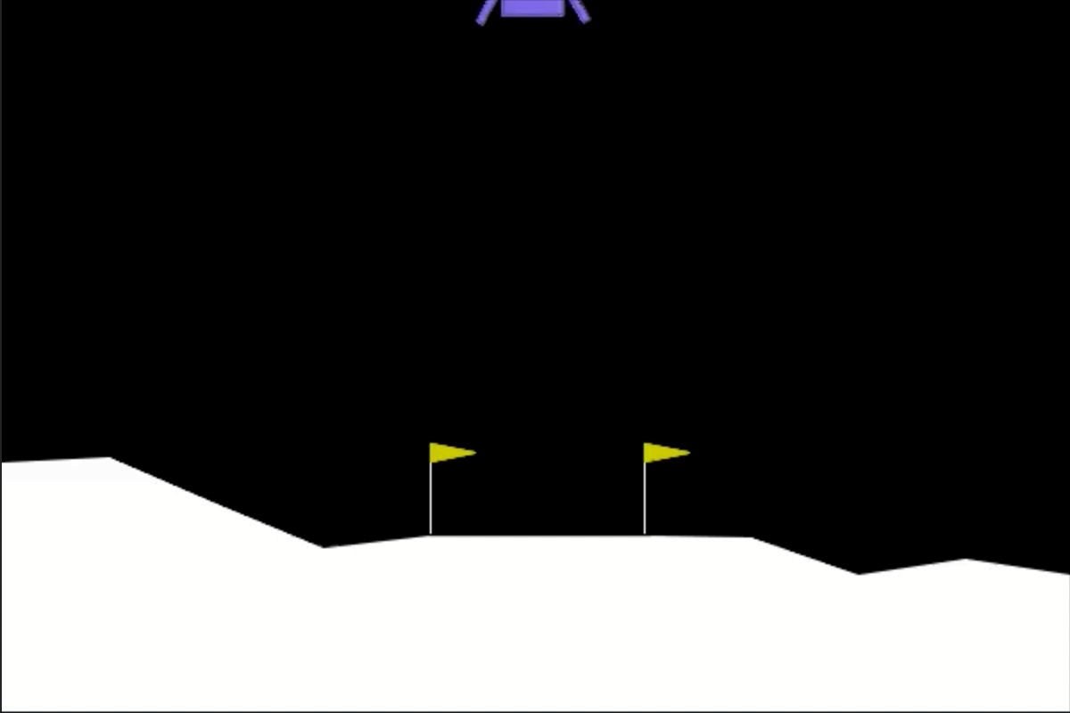
Lunar Lander Before and After Video
Evaluated at λ = 0.5, prompt = "balanced", for up to 500 steps
total return 76.69
total return 211.12

Slide 22
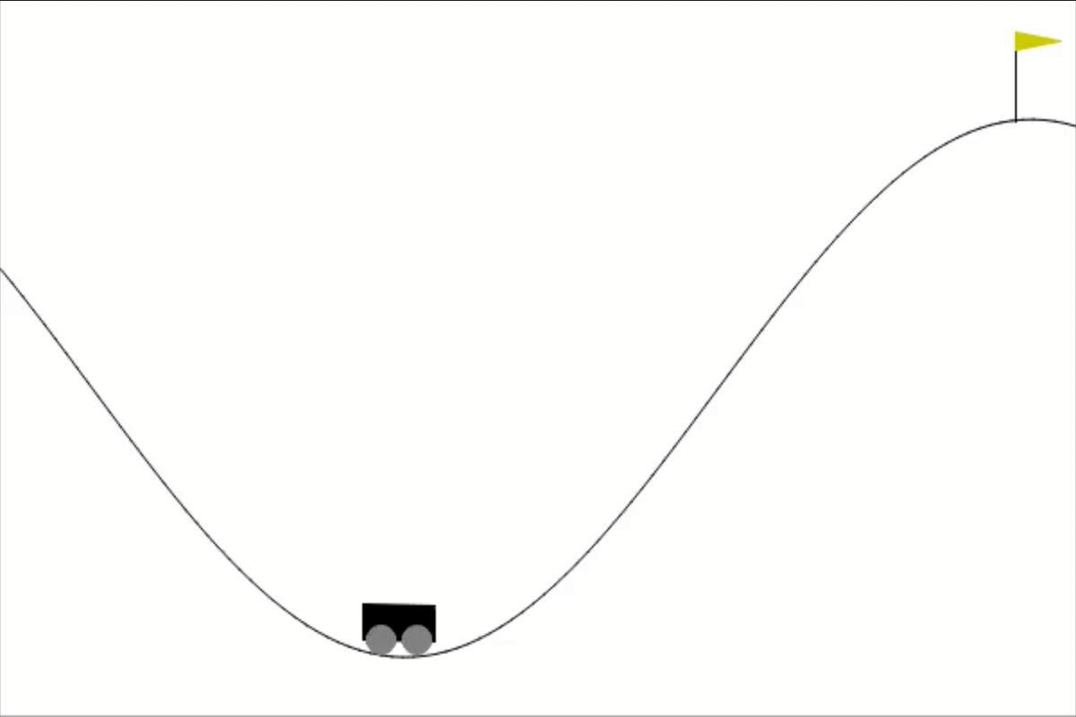
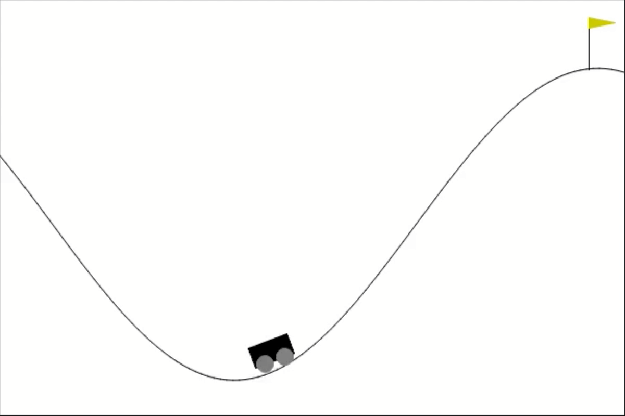
Mountaincar Before and After Video
Evaluated at λ = 0.5, prompt = "balanced", for up to 500 steps
total return 79.83
total return 140.78

Slide 23
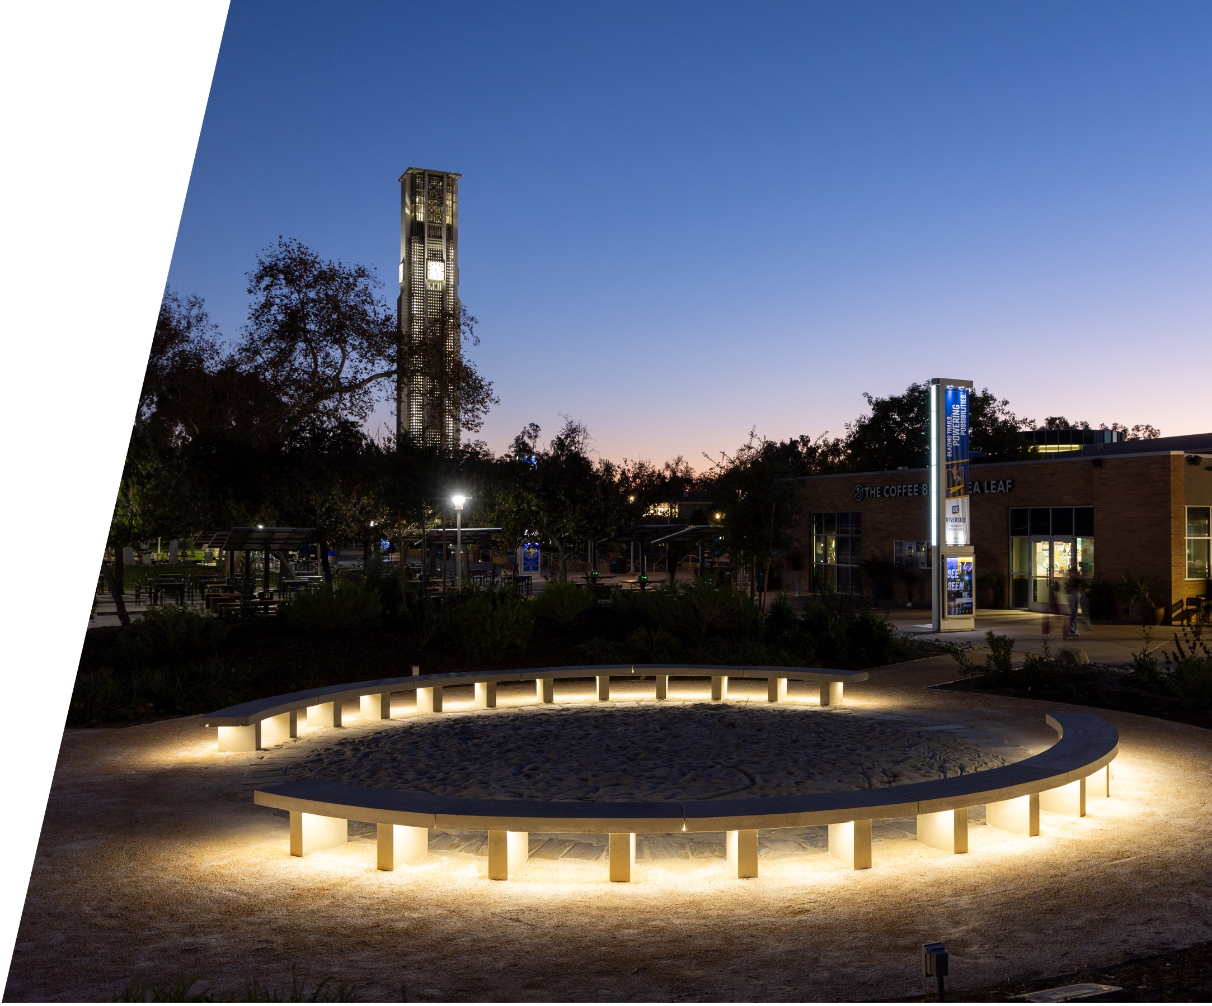

Thank You
Questions or Feedback?

